Slide 1
Design & Implement Community Portal Database
Module Project
Module: Database Design and Implementation
Course: NICF-Advanced Certificate in Infocomm Technology (Software & Applications)
Start Date : 21 July 2022
End Date : 10 August 2022
Submission Date : 8 August 2022
Learner Name : Wildan Luqmanul Hakim
Enrollment ID : BDSE-0322
Presentation Date :

Slide 2
Contents
Document History
Version Number | Effective Date of release | Summary of Included Changes | Author
1 | 4th March 2016 | First Edition | Satya CVS
4 | 26th July 2017 | Changed for Module 4 | Shrinivas K R
5 | 5th June 2018 | Changed for Module 4 RQF | Shrinivas K R

Slide 3
Contents
Contents
S. No. | Description
01 | Development Tools
02 | Database Requirements
03 | Entities
04 | Conceptual Design
05 | Logical Design
06 | Tables
07 | Fields
08 | Primary Key, Foreign Key & Indexes
09 | SQL Queries
10 | Report Queries
11 | Indexes
12 | Backup Script
13 | Project Milestones & Tasks

Slide 4
Contents
Contents
S. No. | Description
17 | Milestone Feedback & Action taken
18 | Modifications Made based On Feedback
19 | Project Results
20 | Proposed Improvements

Slide 5
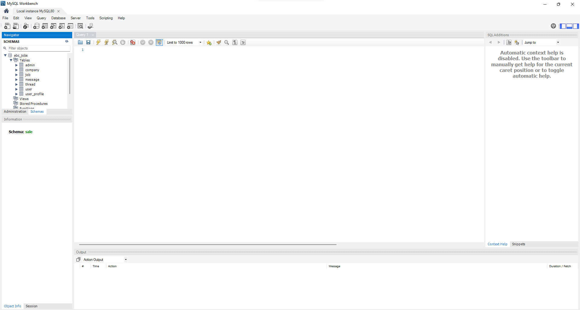
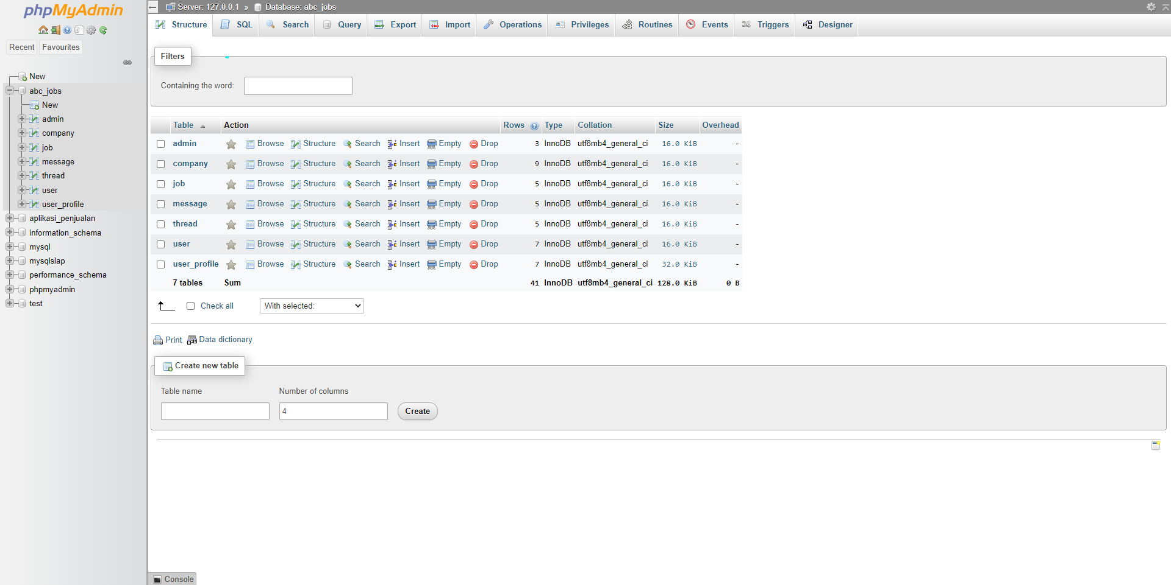
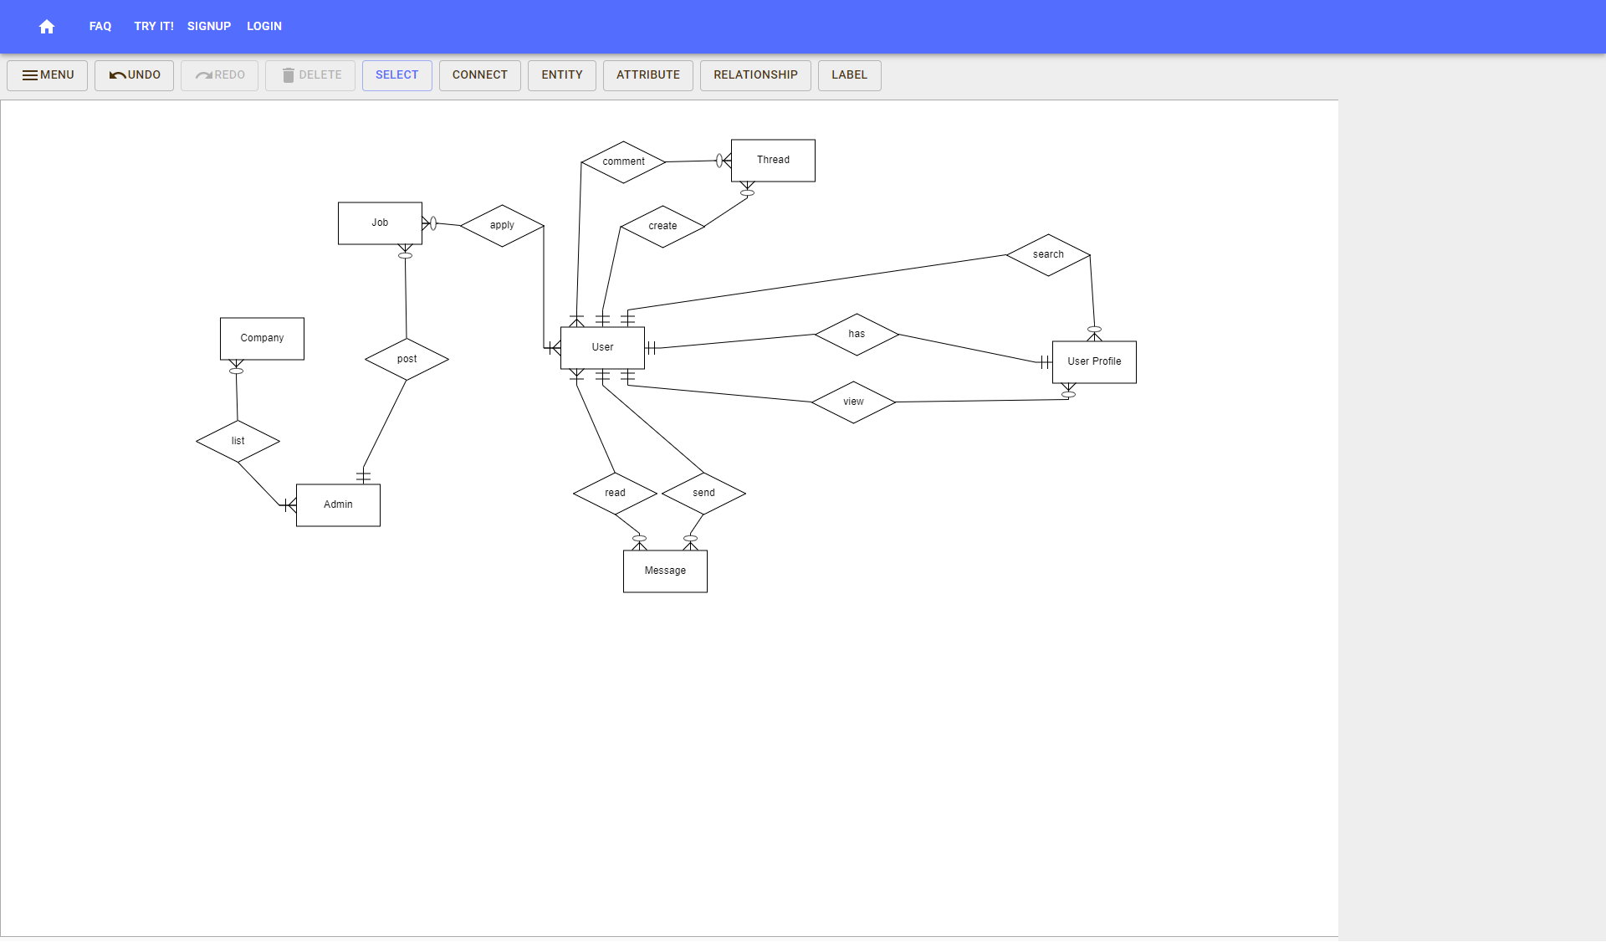
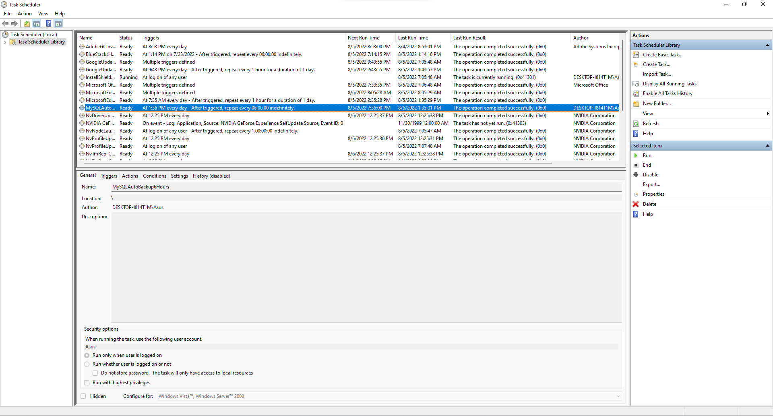
1. Development Tools
MySQL Workbench 8.0
phpmyadmin
ERDPlus.com
Windows Task Scheduler

Slide 6
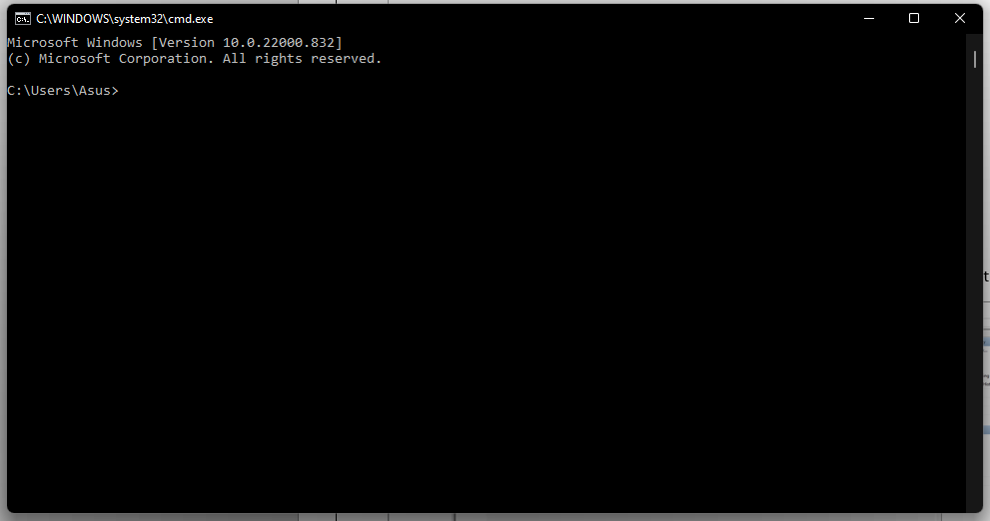
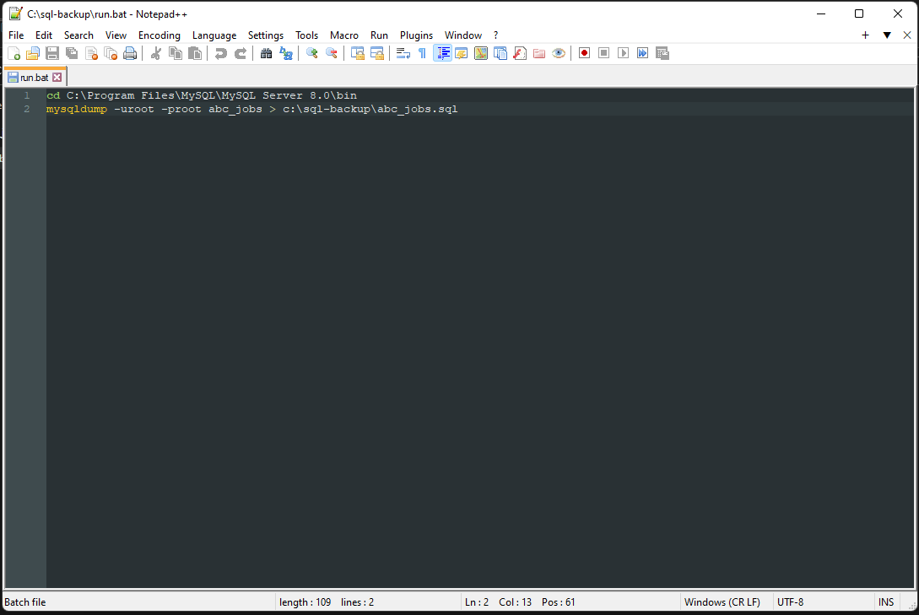
1. Development Tools
Command Prompt
Notepad++

Slide 7



2. Database Requirements
System Requirements
Hardware Requirements
Software Requirements
Processor : Intel Core or Xeon 3GHz (or Dual Core 2GHz) or equal AMD CPU.
Memory : 4 GB (6 GB recommended).
Graphic Accelerators : nVidia or ATI with support of OpenGL 1.5 or higher.
MySQL WorkBench
XAMPP

Slide 8
3. Entities
Entity and attributes for ABC Job Portal
No. | Entities | Description | Attributes | Page/Function
1 | User | Registered user is uniquely identified in the portal with a User ID | User_id First_name Last_name Company City Country Email Password | Register Page Login Page Profile Page Forget Password Page
2 | User Profile | 1 User ID can have 1 profile with general information, contact information and uniquely identified by a Profile ID | User_id Status_id Username Experience Company bio | Profile Page Update Profile Page Search User View Users Public Profile List Search Results
3 | Admin | Admin can posts job and can list companies | Admin_id First_name Last_name Email Password | Administater User Data

Slide 9
3. Entities
Entity and attributes for ABC Job Portal
No. | Entities | Description | Attributes | Page/Function
4 | Company | Admin listed company in ABC Jobs | Company_id Company_name Company_address
5 | job | Registered user can post job opportunities, apply or list job opportunities and responses | Job_id Company_name Job_desc Job_type | Post Job Opportunities List Job Opportunities List Job Responses
6 | thread | Registered user can create threads and comment to a thread | Thread_id Date Time Thread_desc Comment | Create Threads Reply Threads Read Threads
7 | message | Registered user can send and read messages to and from other users | Message_id Date Time Message To From | Send Messages Read Messages Post in Message Board List Message Board

Slide 10
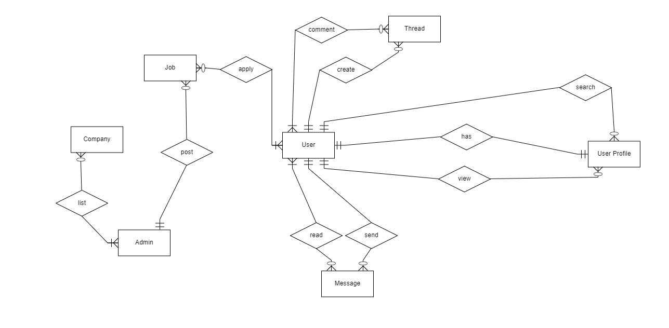
4. Conceptual Design

Slide 11
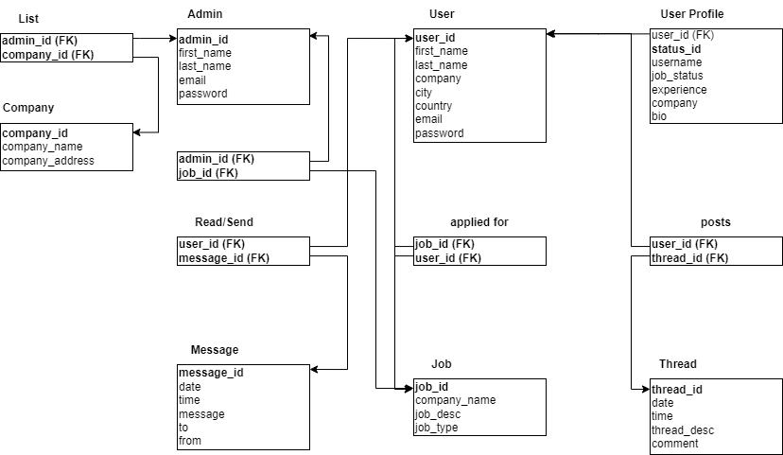
5. Logical Design

Slide 12
6. Tables
Tables
S. No. | Tables | Purpose of Table
1 | user | Data for user has registered on ABC Jobs
2 | user_profile | Data for user profile has registered on ABC Jobs
3 | admin | Data admin manage ABC Jobs
4 | company | Data company listed on ABC Jobs
5 | job | Data job posted by admin and user can apply for the job
6 | thread | Data post thread from user
7 | message | Data message from user to other user

Slide 13
7. Fields
User
S. No. | Field | Description
1 | User_id | Primary key for user table
2 | First_name | User first name
3 | Last_name | User last name
4 | company | User company
5 | city | User city
6 | country | User country
7 | email | User email for login
8 | password | User password for login

Slide 14
7. Fields
User_profile
S. No. | Field | Description
1 | User_id | Unique key for user_profile table
2 | Status_id | Primary key for user profile table
3 | username | User username
4 | job_status | User job status
5 | experience | User experience at job
6 | company | User work in company
7 | bio | User

Slide 15
7. Fields
Admin
S. No. | Field | Description
1 | Admin_id | Primary key for admin table
2 | First_name | Admin first name
3 | Last_name | Admin last name
4 | email | Admin email for login
5 | password | Admin password for login

Slide 16
7. Fields
Company
Job
S. No. | Field | Description
1 | company_id | Primary key for company table
2 | company_name | Company name
3 | company_address | Company address
S. No. | Field | Description
1 | job_id | Primary key for job table
2 | company_name | Company name for job
3 | job_desc | Job description
4 | job_type | Type job

Slide 17
7. Fields
Thread
Message
S. No. | Field | Description
1 | thread_id | Primary key for thread table
2 | date | Thread posted date
3 | time | Thread posted time
4 | thread_desc | Thread description
5 | comment | Thread comment
S. No. | Field | Description
1 | message_id | Primary key for message table
2 | date | Message created date
3 | time | Message created time
4 | message | Message description
5 | to | Message sender
6 | from | Message receipent

Slide 18
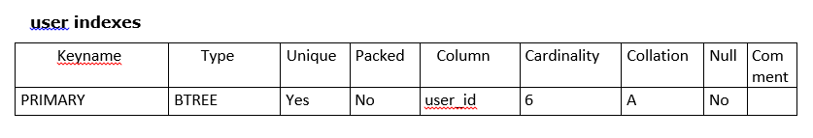
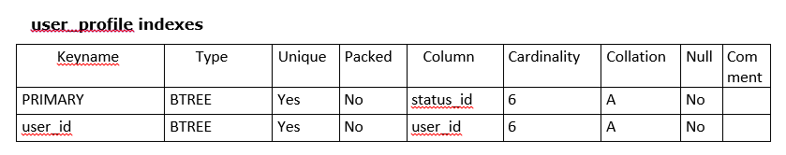
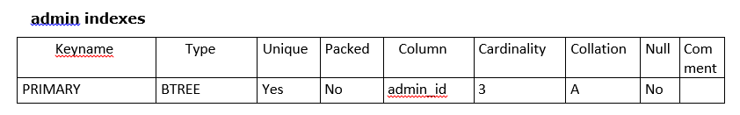
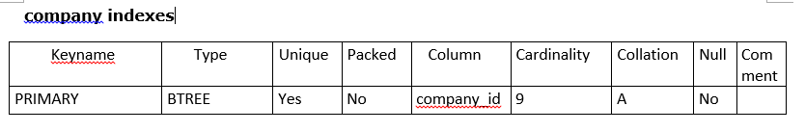
8. Primary Key, Foreign Key & Indexes

Slide 19
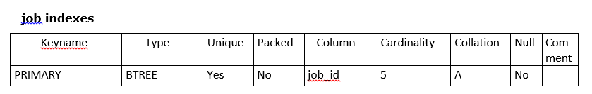
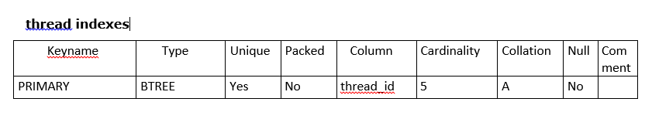
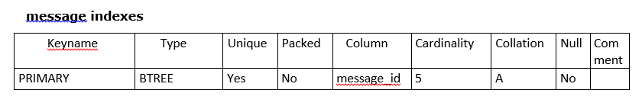
8. Primary Key, Foreign Key & Indexes

Slide 20
9. SQL Queries
S. No. | Purpose of Query | Query
1 | Create database ABC Jobs | CREATE DATABASE abc_jobs;
2 | Create table in database ABC Jobs | CREATE TABLE user (`user_id` INT(11) NOT NULL AUTO_INCREMENT, `first_name` VARCHAR(48) NOT NULL , `last_name` VARCHAR(48) NOT NULL , `company` VARCHAR(48) NOT NULL , `city` VARCHAR(48) NOT NULL , `country` VARCHAR(48) NOT NULL , `email` VARCHAR(64) NOT NULL , `password` VARCHAR(32) NOT NULL , PRIMARY KEY (`user_id`));
3 | Insert data into table | INSERT INTO user (`user_id`, `first_name`, `last_name`, `company`, `city`, `country`, `email`, `password`) VALUES (‘6', 'Wildan', 'Luqmanul Hakim', 'Google', 'Bandung', 'Indonesia', 'wildanluqmanul@gmail.com', 'password123');
4 | Update data in the table | UPDATE user SET first_name = ‘User’, last_name = ‘Name’ WHERE user_id = ‘6’;
5 | Delete data in the table | DELETE FROM user WHERE user_id = ‘7’;
6 | Show data in the table | SELECT * FROM user;
7 | Search data in the table | SELECT * FROM user WHERE first_name LIKE '[value]' OR last_name LIKE ‘[value]’ OR company LIKE ‘[value]’ OR city LIKE ‘[value]’ OR country LIKE ‘[value]’;
8 | Create new user creation | CREATE USER 'root2'@'localhost' IDENTIFIED BY '123456';

Slide 21
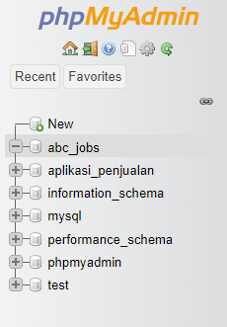
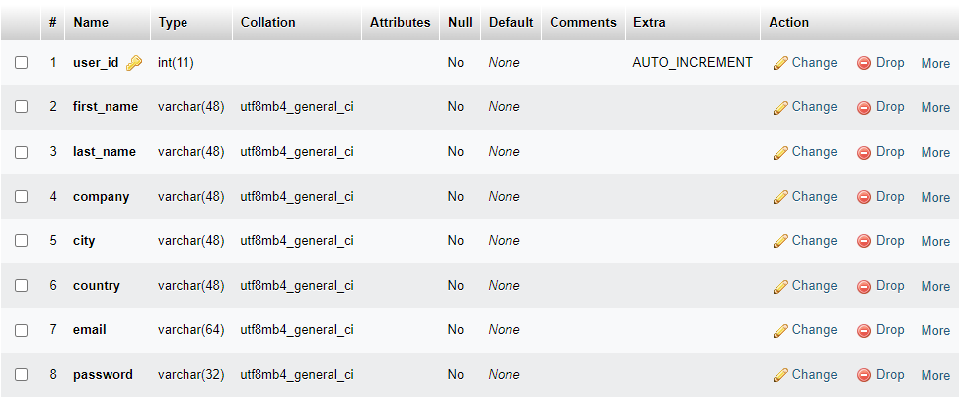
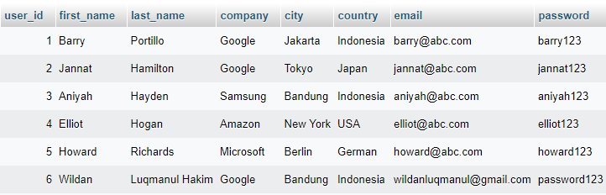
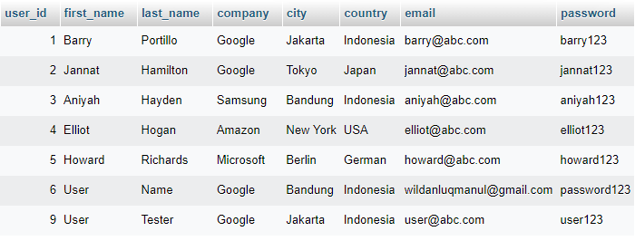
9. SQL Queries
Create ABC_Jobs
Create user table
Insert data into table
update data in the table

Slide 22
10. Report Queries
S. No. | Purpose of Query | Query | Evidence
1 | All users contact info. To fetch users, contact info information | SELECT user_id, CONCAT(first_name, " ", last_name) AS Name, CONCAT(city,", ",country) AS Location, email AS Email FROM user ORDER BY Name; | Report users contact log
2 | All jobs type info, To fetch job type information | SELECT job_id, company_name AS Company, job_desc AS Description, job_type AS Job_Type FROM job ORDER BY Job_Type; | Report jobs type log
3 | All users thread. To fetch users thread information | SELECT user.user_id, CONCAT(user.first_name, ' ' ,user.last_name) AS Name, CONCAT(thread.date, ' ' ,thread.time) AS Date, thread.thread_desc, thread.comment FROM user JOIN thread ON user.user_id=thread.thread_id ORDER BY Name; | Report users thread information

Slide 23
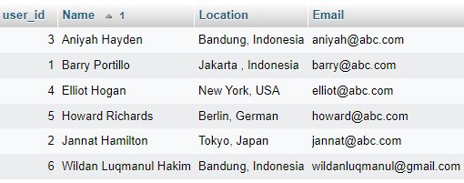
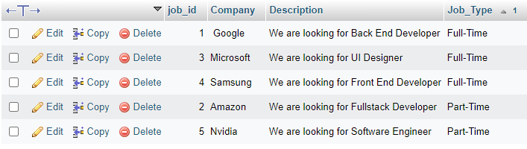
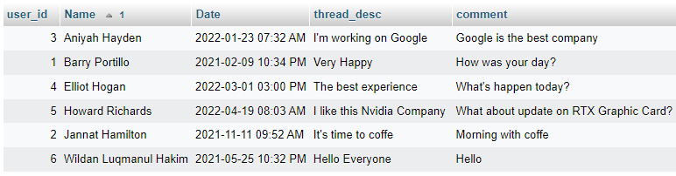
10. Report Queries
Report users contact log
Report job type log
Report users thread information

Slide 24
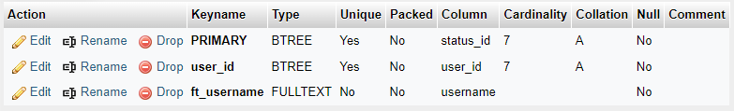
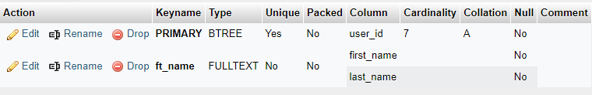

11. Indexes
Indexes for username
CREATE FULLTEXT INDEX ft_username ON user_profile(username);
Indexes for Name
CREATE FULLTEXT INDEX ft_name ON user(first_name, last_name);
Indexes for Company Name
CREATE FULLTEXT INDEX ft_company ON company(company_name);

Slide 25
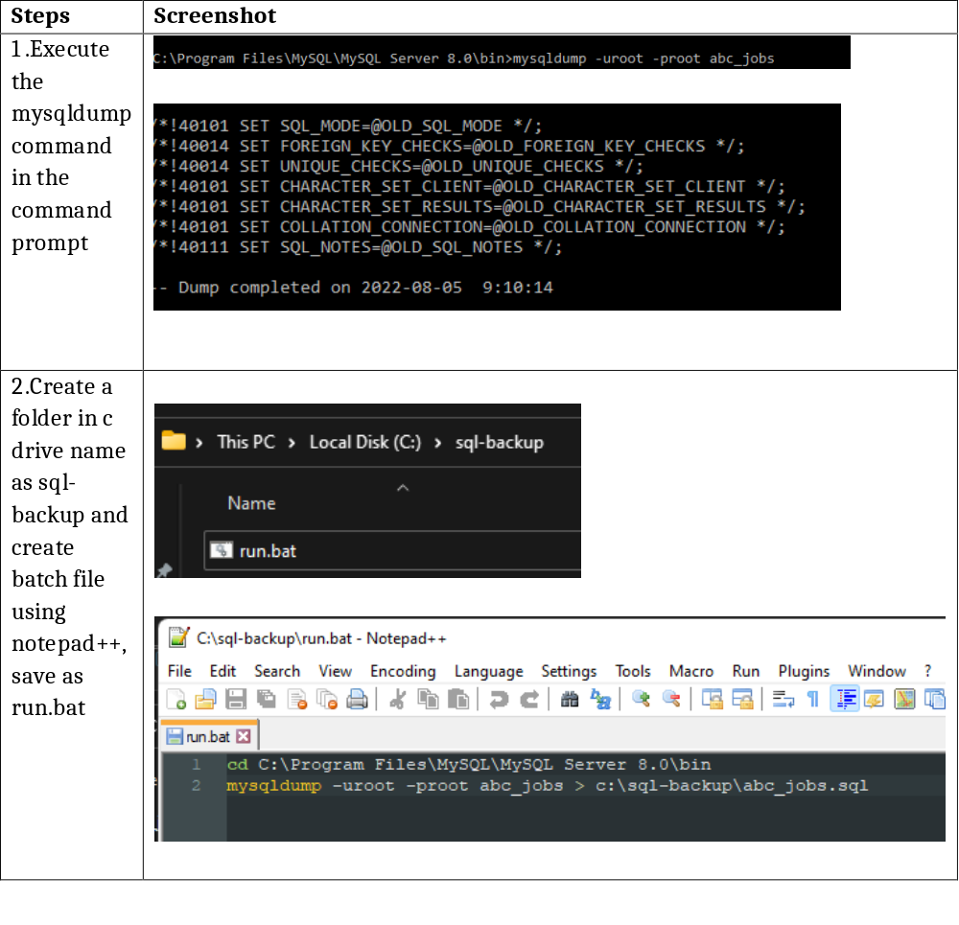
12. Backup Script

Slide 26
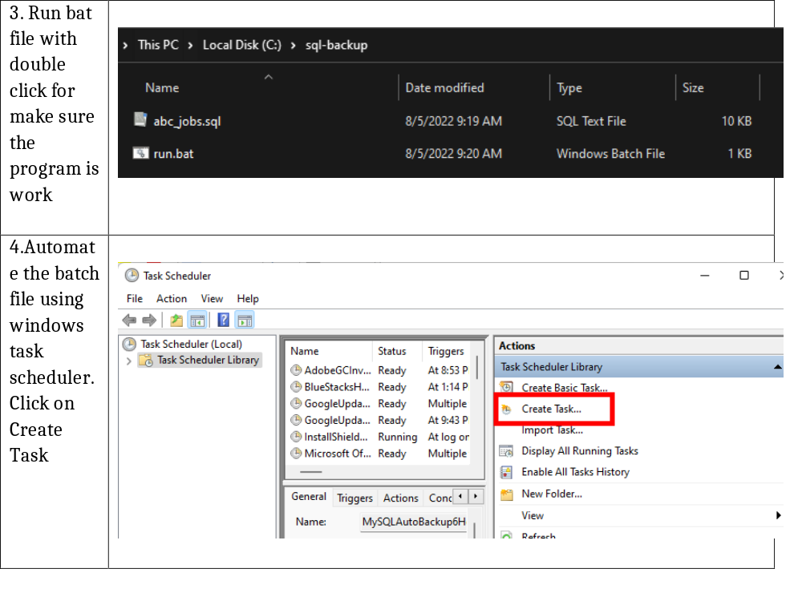
12. Backup Script

Slide 27
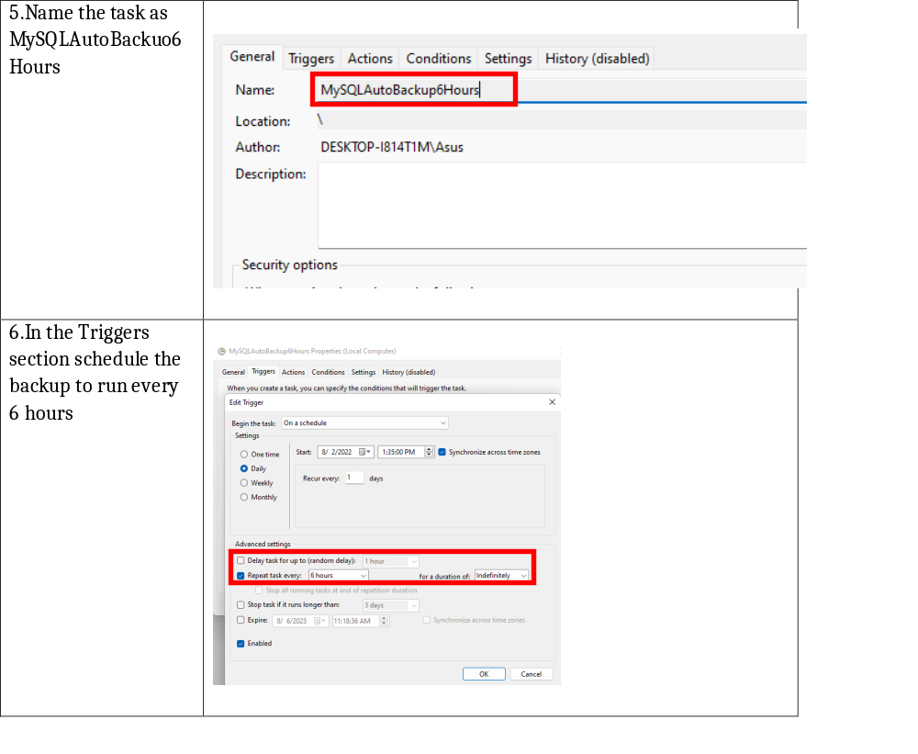
12. Backup Script

Slide 28
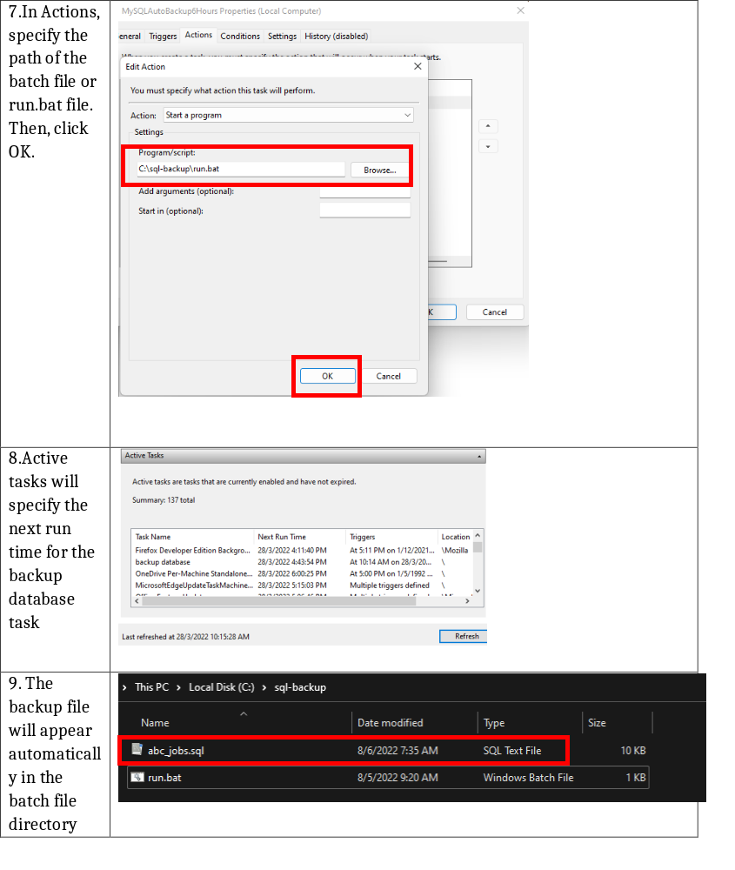
12. Backup Script

Slide 29
13. Project Milestones & Tasks
Project Task ID | Project Major Task Description | Project Milestone ID
1 | Setup the Development Environment based on the Technical Development Environment | 1
2 | Power point detailing the entities, tables and fields which need to created | 1
3 | Power point will also include Conceptual, Logical Design | 1
4 | Develop the Schema creation script or Implement using phpMyAdmin | 2
5 | Power point which Analyze and list the Queries which need to be created based on project requirements | 3
6 | Indexes & Backup Script | 3

Slide 30
14. Milestone Feedback & Action taken
Project Milestone ID | Milestone Feedback received from Tutor / Learning Facilitator | Action Taken (Yes / No)
1 | -
 | -
 | -
 | -
2 | -
 | -
 | -
 | -
3 | -
 | -
 | -
 | -
 | -

Slide 31
15. Modifications Made based On Feedback

Slide 32
16. Project Results
List of Tables
  user
  user_profile
  admin
  company
  job
  thread
  message

Slide 33
17. Proposed Improvements
List of Improvements
  Connect all tables with user_id
  Remove table if the table is useless

